Slide 1

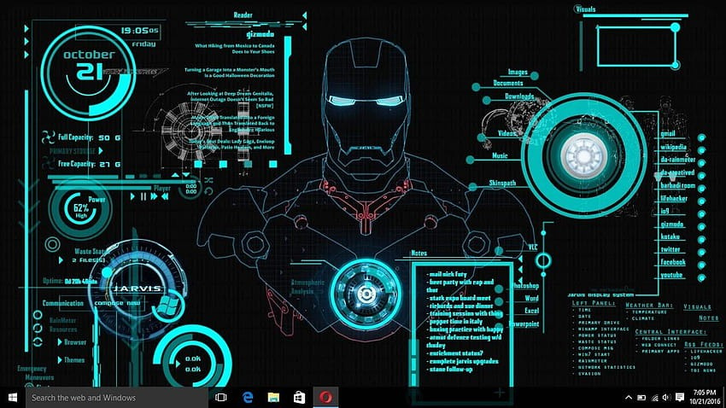

Introduction
Title: JARVIS(Just A Rather Very Intelligent System)
JARVIS is a Python-based virtual assistant inspired by the AI assistant from the Iron Man movies. It’s designed to interact with users through a graphical user interface (GUI) and voice commands. Our version of JARVIS can listen to spoken words, convert them to text, and respond using text-to-speech technology. It also visually engages users by displaying animated GIFs and a real-time clock.

Slide 2


Why did we choose JARVIS
Fascinated with AI and virtual assistant

Slide 3
Why did we choose JARVIS
Fascinated with AI and virtual assistant
We can make it a long term project

Slide 4
Why did we choose JARVIS
Fascinated with AI and virtual assistant
We can make it a long term project
Learning opportuinity in python, speech recognition, GUI development etc

Slide 5


MISSION

Slide 6
MISSION
01. TWO WAY INTERACTION
Right now Jarvis only detects our speech and writes down the detected voice

Slide 7
MISSION
01. TWO WAY INTERACTION
Right now Jarvis only detects our speech and writes down the detected voice
02. INTEGRATE CHAT-GPT
JARVIS will take our voice commands to the chat-gpt and will give us the response.

Slide 8
MISSION
01. TWO WAY INTERACTION
Right now Jarvis only detects our speech and writes down the detected voice
02. INTEGRATE CHAT-GPT
JARVIS will take our voice commands to the chat-gpt and will give us the response.
03. ACCESS OTHER APPLICATIONS
Make JARVIS as an apk and also make it access other applications and run them on behalf of us, like opening browser and read and send mails.

Slide 9

modules and functions
Modules
tkinter
pillow
pyttsx3
SpeechRecognition
threading
time

Slide 10
modules and functions
Modules
Functions
tkinter
pillow
pyttsx3
SpeechRecognition
threading
time
speak
load_gif_frames
play_gif
start_talk
exit_program
listen_for_speech
update_clock

Slide 11
module: pyttsx3
pyttsx3 is a Python library that converts text to speech, enabling applications to "speak" by generating audible output. It works offline and supports multiple voices and speech rates, making it ideal for creating voice-enabled applications like JARVIS.

Slide 12
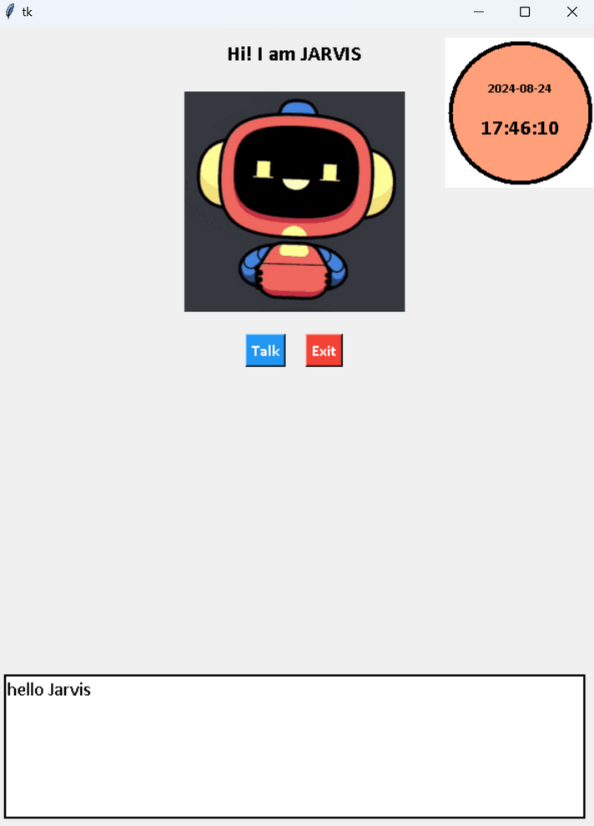
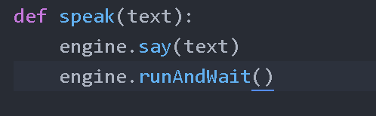

module: pyttsx3
pyttsx3 is a Python library that converts text to speech, enabling applications to "speak" by generating audible output. It works offline and supports multiple voices and speech rates, making it ideal for creating voice-enabled applications like JARVIS.
Function: speak(text)
The speak function in JARVIS uses pyttsx3 to convert a given text into spoken words, allowing JARVIS to verbally respond to user commands.

Slide 13
module: tkinter
tkinter is a Python library used for creating graphical user interfaces (GUIs). It provides tools for building windows, buttons, labels, and other interactive elements in desktop applications.

Slide 14
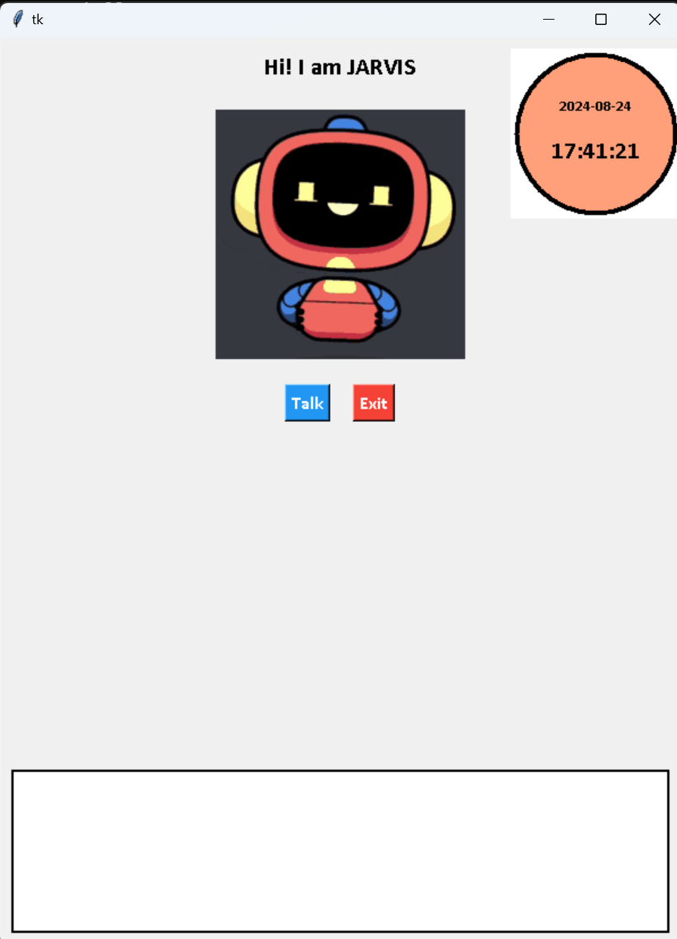
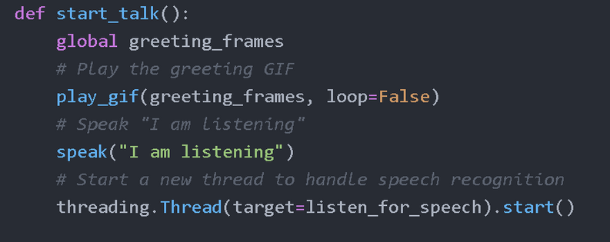
module: tkinter
tkinter is a Python library used for creating graphical user interfaces (GUIs). It provides tools for building windows, buttons, labels, and other interactive elements in desktop applications.
Function: start_talk
The start_talk function in JARVIS plays a greeting GIF, speaks a message to indicate it's listening, and starts a separate thread to process voice commands.

Slide 15
module: pillow(PIL)
Pillow is a Python library for image processing that allows you to open, manipulate, and save various image file formats. It supports tasks like resizing, cropping, and converting images, as well as handling GIFs and other image operations.

Slide 16

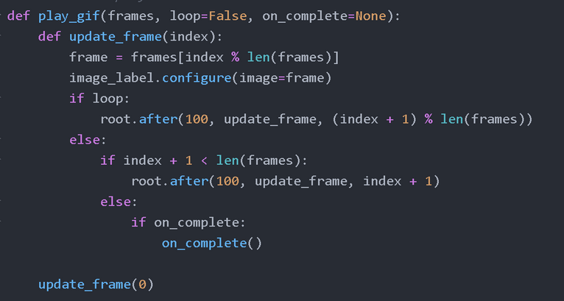
module: pillow(PIL)
Pillow is a Python library for image processing that allows you to open, manipulate, and save various image file formats. It supports tasks like resizing, cropping, and converting images, as well as handling GIFs and other image operations.
Function: play_gif
The play_gif function in JARVIS animates GIFs by cycling through their frames in the GUI. It can loop the animation continuously or play it once, with the option to trigger additional actions when the animation completes.

Slide 17
module: speech_recognition
speech_recognition is a Python library that converts spoken words into text by capturing audio from a microphone and processing it with various speech-to-text engines, like Google's Web Speech API

Slide 18
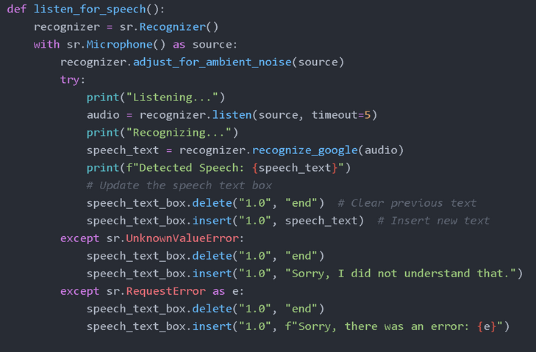
module: speech_recognition
speech_recognition is a Python library that converts spoken words into text by capturing audio from a microphone and processing it with various speech-to-text engines, like Google's Web Speech API
Function: listen_for_speech
The listen_for_speech function in JARVIS captures audio from the microphone, converts it to text using the speech_recognition library, and then displays the recognized speech in the text box.

Slide 19
module: time
The time module in Python provides functions for working with time, such as getting the current time, pausing execution, and formatting time and date strings. It's essential for tasks that involve timing or scheduling.

Slide 20
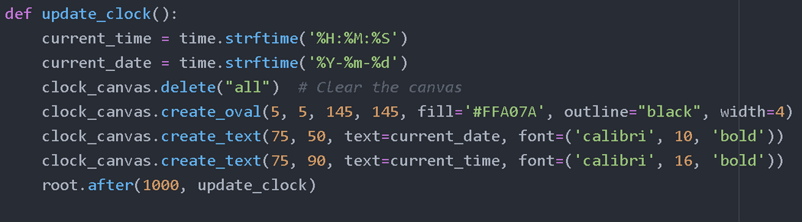
module: time
The time module in Python provides functions for working with time, such as getting the current time, pausing execution, and formatting time and date strings. It's essential for tasks that involve timing or scheduling.
The update_clock function in JARVIS continuously updates and displays the current time and date on the GUI, creating a real-time digital clock effec
Function: update_clock

Slide 21
module: threading
threading is a Python module that allows concurrent execution of code by running multiple threads. It’s useful for performing background tasks, like listening for speech, without freezing the main application

Slide 22
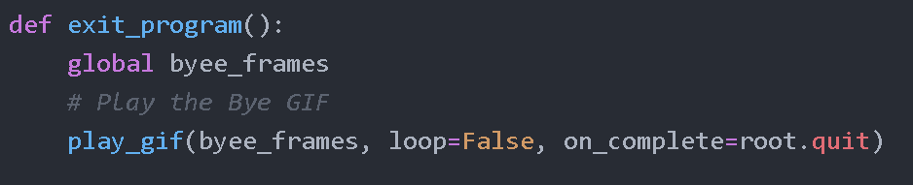
module: threading
threading is a Python module that allows concurrent execution of code by running multiple threads. It’s useful for performing background tasks, like listening for speech, without freezing the main application
Function: exit_program
The exit_program function in JARVIS plays a farewell GIF and then safely closes the application, ensuring a smooth exit process.

Slide 23

conclusion
In conclusion, our JARVIS project demonstrates an engaging and interactive virtual assistant built using Python. By integrating key technologies like tkinter for the GUI, pyttsx3 for text-to-speech, and speech_recognition for voice commands, we created a system that not only listens and responds but also provides a dynamic user experience with GIF animations and real-time updates. This project has deepened our understanding of AI, multi-threading showcasing our ability to combine these elements into a cohesive and functional assistant. We look forward to exploring further enhancements and applications of such intelligent systems.

